Slide 1
Vampire Facelift®
October, 2015
Orlando

Slide 2
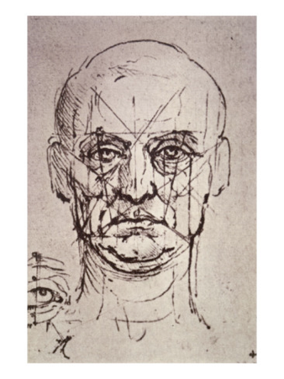

Slide 3
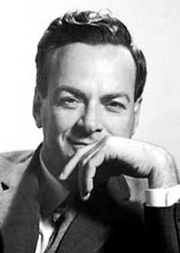

Slide 4
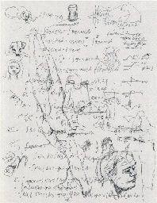

Slide 7
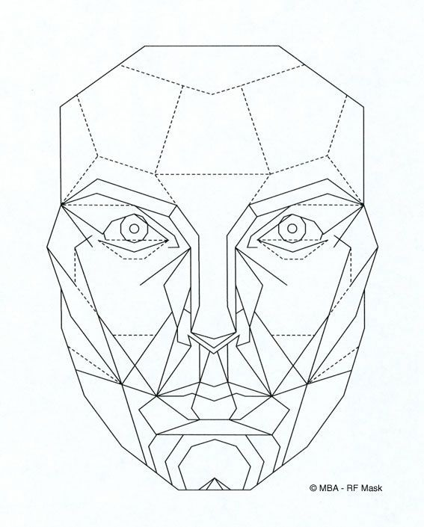

Slide 8
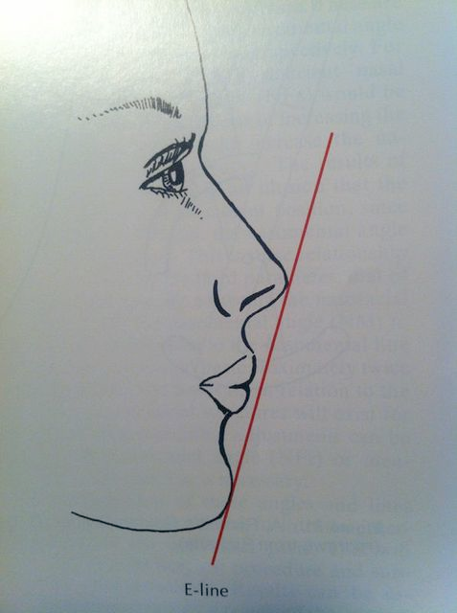

Slide 9
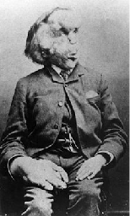

Slide 11
4 Components of Appearance Of Anything
Size
Shape
Color
Texture

Slide 12
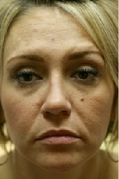

Slide 13
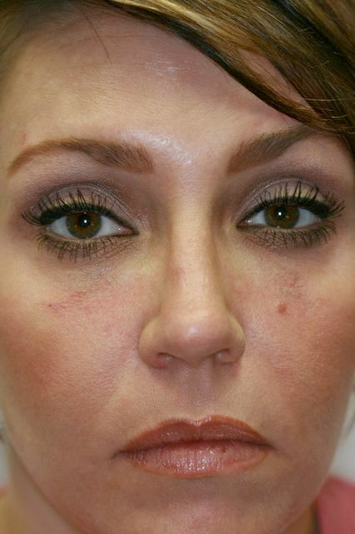

Slide 14
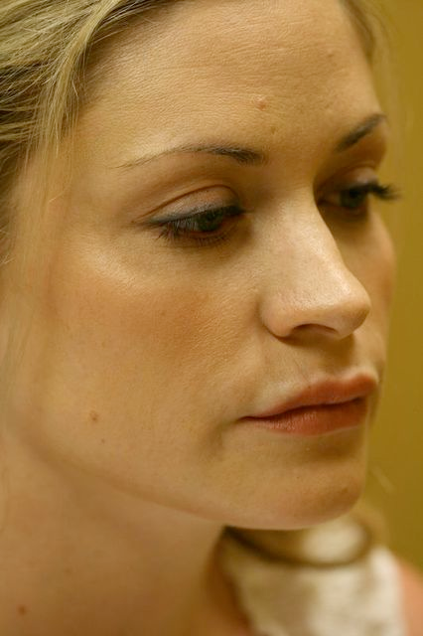

Slide 15
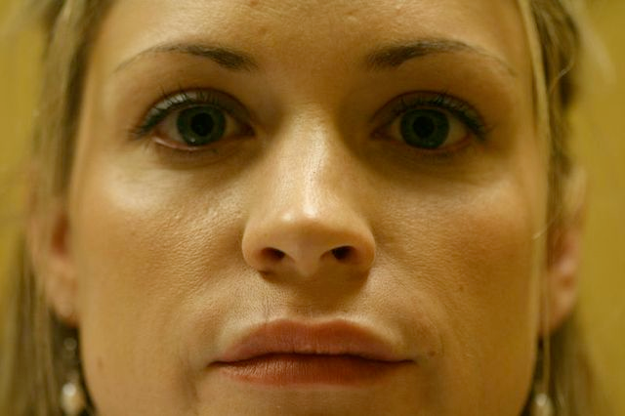

Slide 17
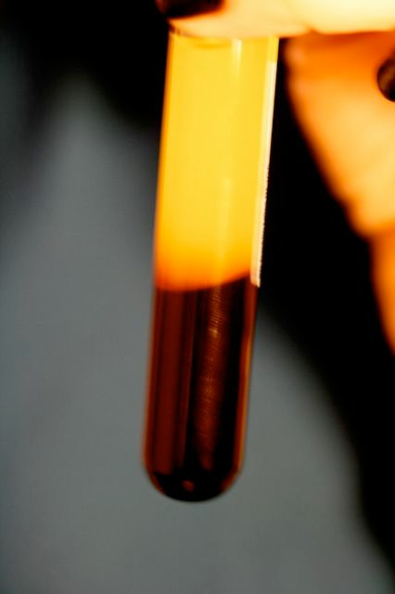

Slide 18
Platelet Derived Growth Factors
Released from the alpha granules in platelets upon activation
Many growth factors and cytokines are involved, including…
IGF (insulin-like growth factor):
PD-EGF (platelet-derived epidermal growth factor)
PDGF (platelet-derived growth factor)
TGF (transforming growth factor)
ECGF (endothelial cell growth)
VEGF (vascular endothelial growth factor)
bFGF (basic fibroblast growth factor)
Cell proliferation, cell differentiation (of unipotent stem cells), & Angiogenesis

Slide 19
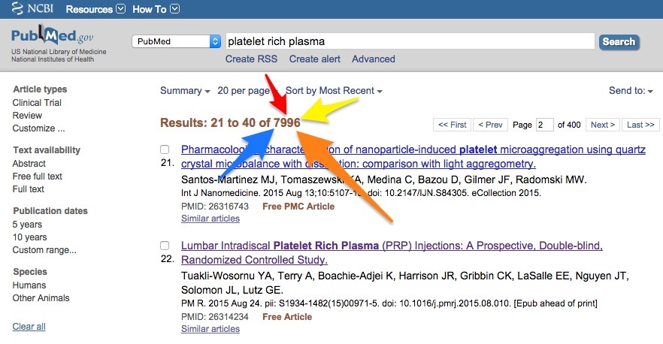
Thousands of papers on PubMed & not one serious side effect… Not One.

Slide 20
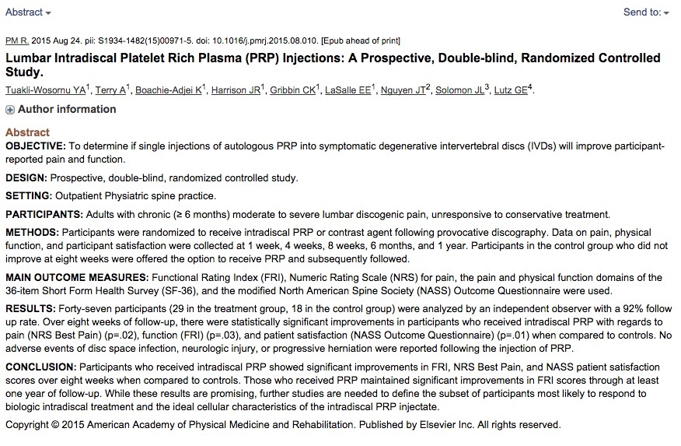
Multiple tissue types studied…

Slide 21
Facial plastic surgery…multiple papers looking at post op recover, post laser, & stand alone…

Slide 22
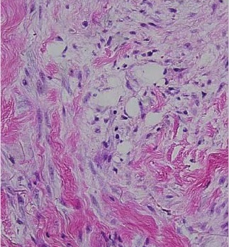
Histological effects of PDGF injection on skin in humans
Fibroblast and adipocyte proliferation, angiogenesis, and collagen deposition
Sclafani & McCormick, 2011

Slide 23
Hyaluronic Acid (HA) Gel
Plus PRP to Recruit & Activate Pluripotent Stem Cells

Slide 24
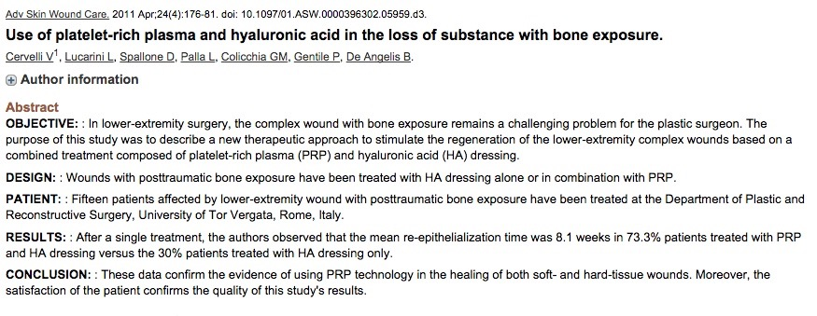
HA as Scaffold Plus
PRP to Recruit & Activate Pluripotent Stem Cells

Slide 25
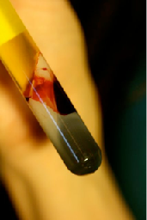

Slide 26
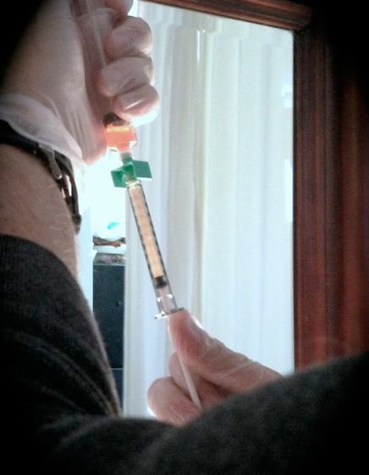

Slide 27
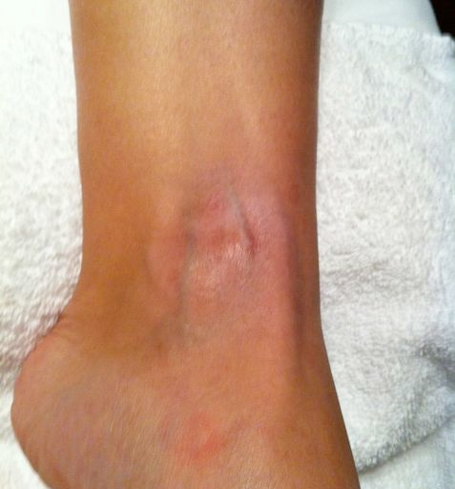

Slide 28
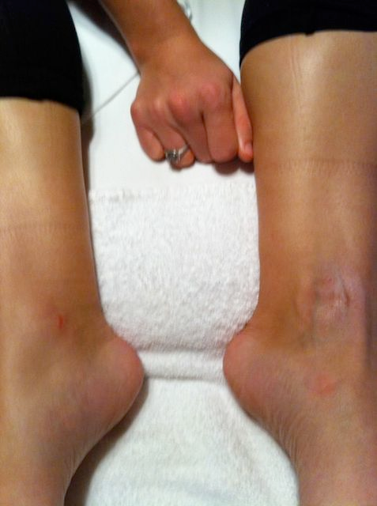

Slide 29
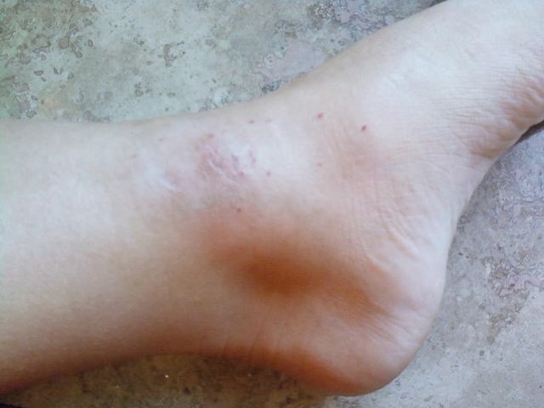

Slide 30
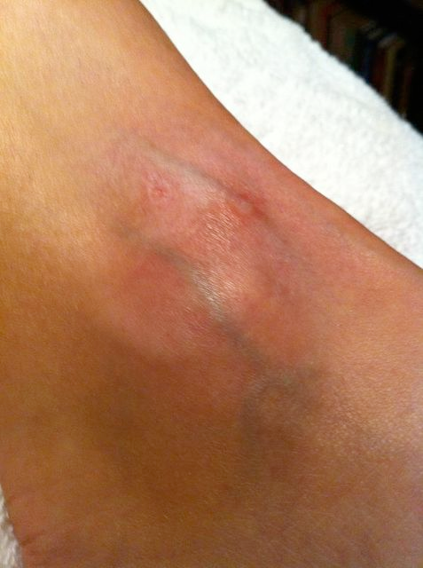

Slide 31
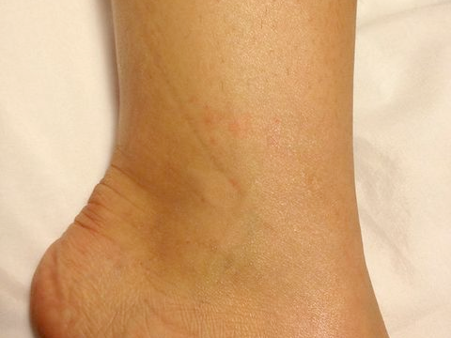

Slide 32
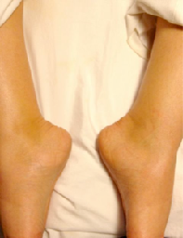

Slide 34
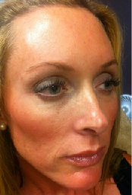

Slide 35
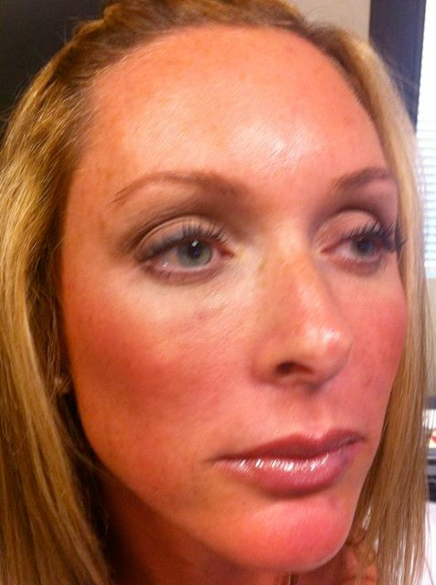

Slide 36
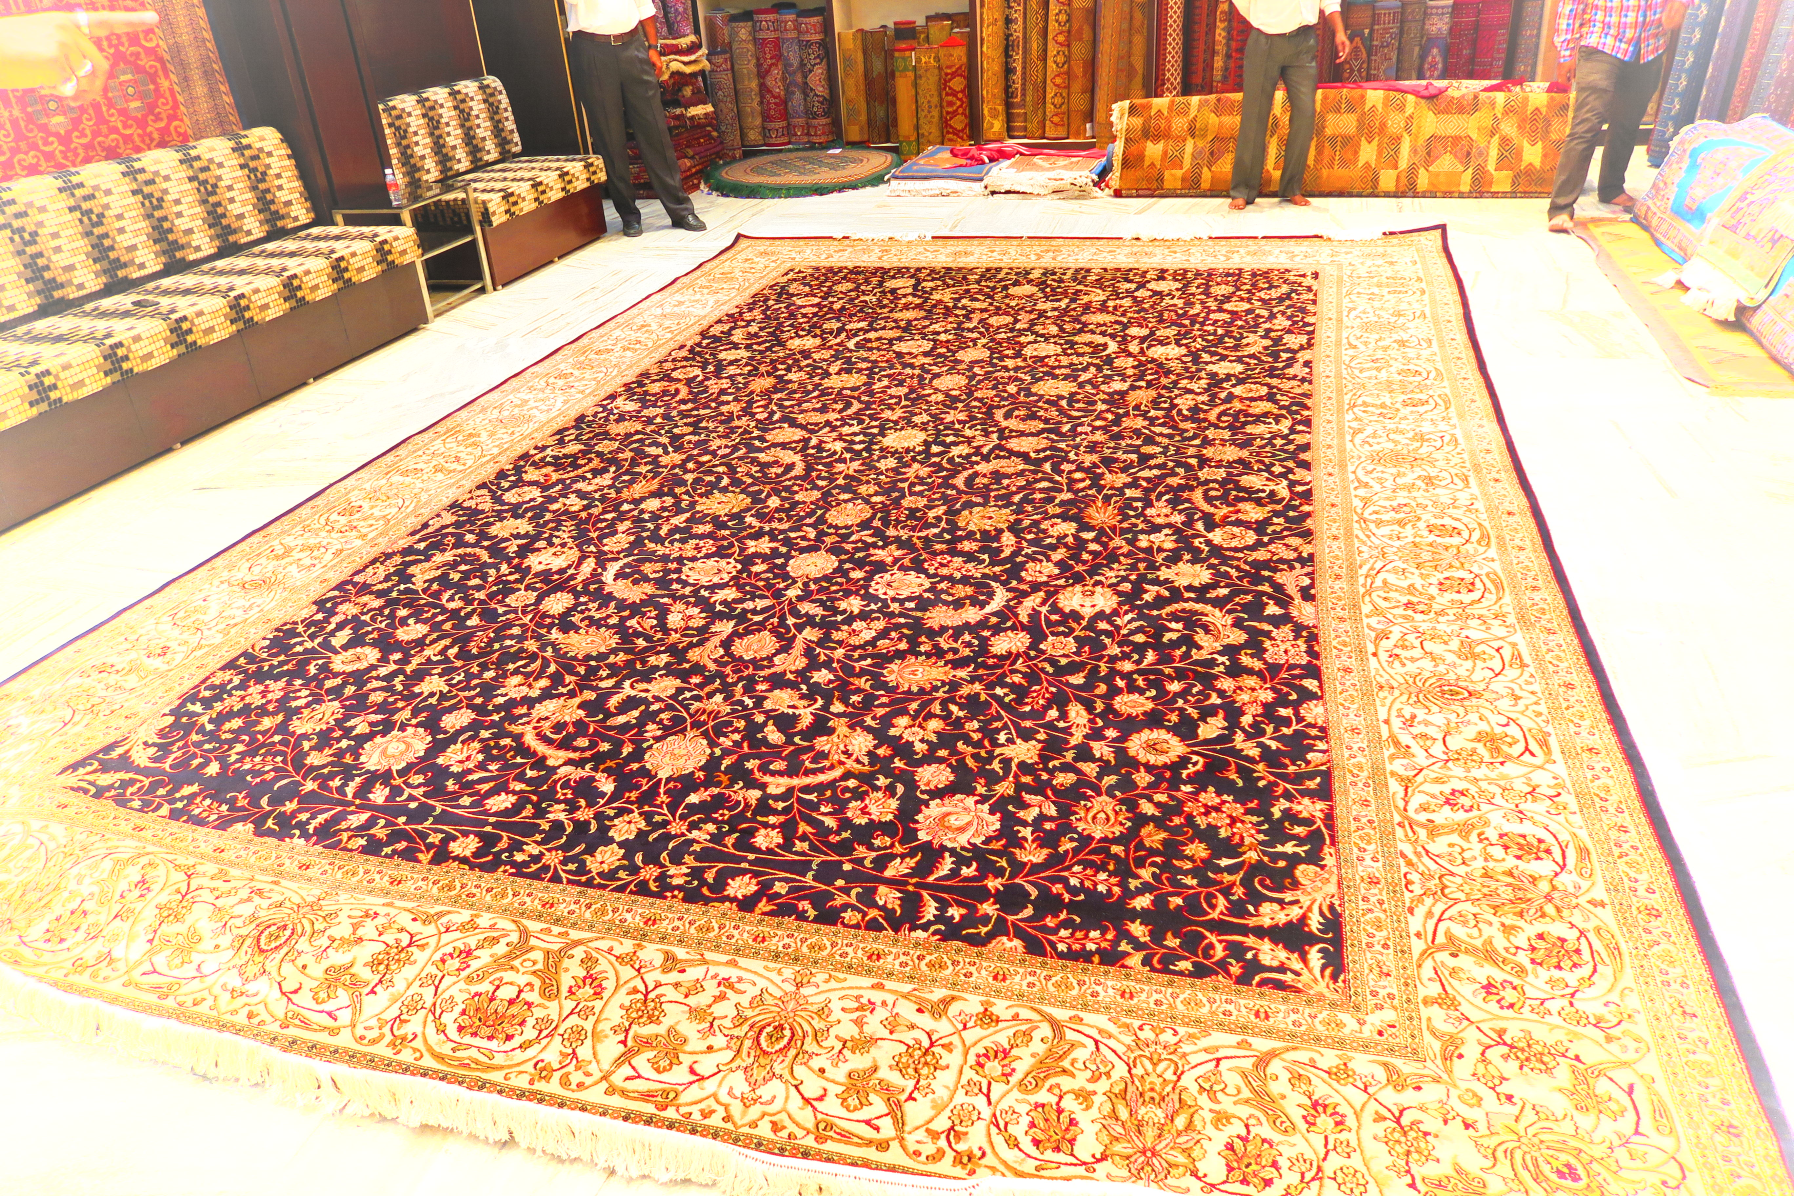
The pride and art of a carpet… can we be as meticulous with the face?
Could the same ideas used for face and bone be used for rejuvenating the tissue of the genitourinary system? The work 6 Years….coming next…
More about facial procedures at VampireFacelift.com/physicians

